Slide 1


Spotify Data Analysis
Using Advance Excel

Slide 2

Acknowledgement
I would like to express my deepest gratitude to DK sir, for the invaluable guidance, feedback, and constant encouragement throughout the duration of this project.

Slide 3


Content
Data Understanding
Data cleaning or wrangling
Data Analysis
Insights

Slide 4

Tool and function used
Tools Used For the Analysis:
Microsoft Excel(2013)
Power Point (2013)
Function used For the Analysis:
Pivot Table(For Quick analysis)
Dynamic Different Types of charts
Text , Month, year etc.
Slicer

Slide 5

Data Overview:
Data understanding:
Rows: 149861
Data Cleaning:
Removed the Duplicated values
Columns: 11
Feature extraction
Convert data into proper tabular format
Checked the data type(handled the conversion if required)
Checked for any NULL, #ERROR,etc. (irrelevant rows)
Columns:
Spotify track uri
ts
Platform
Ms played
Track name
Artist name
Album name
Reason start
Reason end
shuffle
skipped
Month
Day
Year

Slide 6

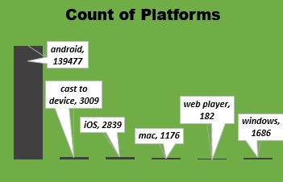
Data Analysis:
Platform Analysis:

Slide 7
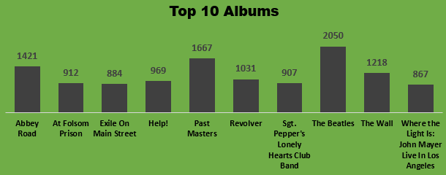
Spotify top Album Analysis:

Slide 8
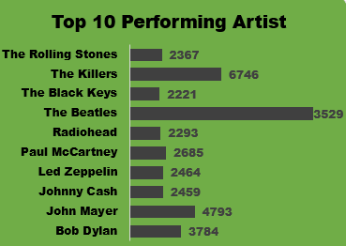
Spotify top Artists Analysis:

Slide 9
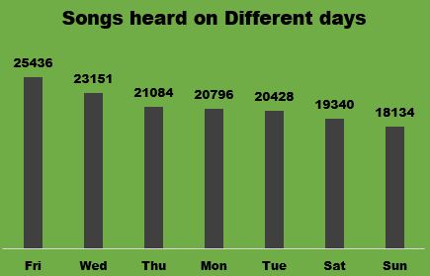
Day Analysis:

Slide 10
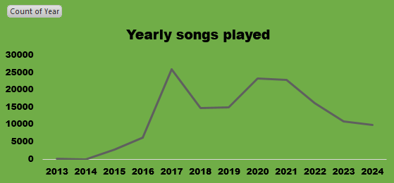
Yearly Analysis:

Slide 11
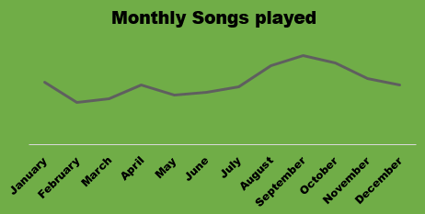
Monthly Analysis:

Slide 12
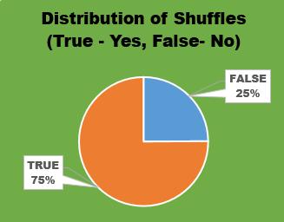
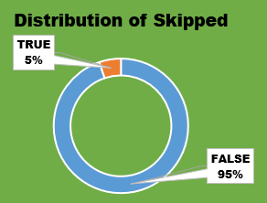
Monthly Analysis:

Slide 13
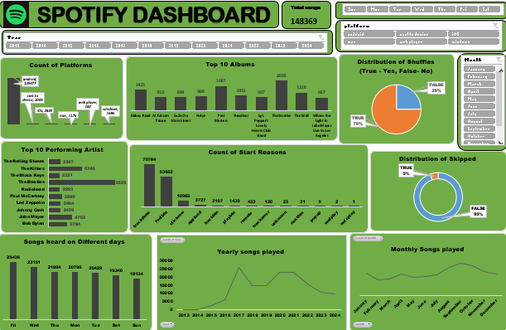
Dashboard Overview

Slide 14


